Slide 1
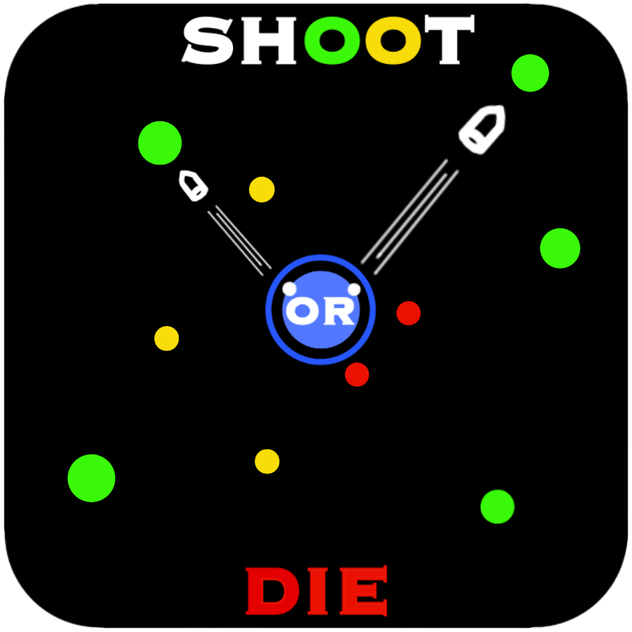
Shoot OR Die
MINI PROJECT-2
Submitted By: Submitted To:
Suryansh Verma (201500726) Dr. Manoj Varshney
Ripunjay Yadav (201500562)
Umang Gupta (201500752)
Aryan Choudhary (201500147)

Slide 2
CONTENTS
- INTRODUCTION : What is Shoot OR DIe ?
- PROBLEM STATEMENT : Why This Application ?
- All about Shoot OR Die
- Tool used
- Outputs images
- References
Conclusion
Future work
- Thank you -
Notes:
FRIENDSHUB

Slide 3
What is Shoot OR Die ?
Welcome to the world of shooting! In this simple yet addictive game, your goal is to shoot as many dots as possible while avoiding obstacles and trying to beat your high score.
Benefits of Shoot OR Die
Dot shooting games can provide a range of benefits, including:
1.Hand-eye coordination: Dot shooting games require players to aim and shoot at moving targets, which can help improve their hand-eye coordination and reaction time.
2.Focus and concentration: These games often involve fast-paced action and require players to stay focused and alert, improving their ability to concentrate and stay focused under pressure.
3.Strategic thinking: Many dot shooting games require players to think strategically about their shots and movements, helping to improve their problem-solving and decision-making skills.
4.Stress relief: Playing dot shooting games can be a fun and engaging way to blow off steam and reduce stress, which can have a positive impact on mental health.
E5.ntertainment: Dot shooting games can provide hours of entertainment and are often easy to pick up and play, making them a popular choice for gamers of all ages and skill levels.

Slide 4
Why is this application ?
Dot shooting games are created for a variety of reasons. Some game developers create these games purely for entertainment and to provide players with a fun and engaging gameplay experience. These games can be a great way to pass the time, relax, and escape from the stresses of everyday life.
In addition to their entertainment value, dot shooting games can also be used for educational or training purposes. For example, some educational games use the dot shooting format to teach skills such as problem-solving, critical thinking, and pattern recognition.
From a game development perspective, dot shooting games can be relatively simple and inexpensive to create, which makes them a popular choice for indie game developers or smaller studios. These games often have straightforward gameplay mechanics and simple graphics, which can make them appealing to a broad range of players.
Overall, the reasons why developers create dot shooting games can vary widely. Whether it's for entertainment, education, or simply as a fun and engaging hobby, dot shooting games continue to be a popular and enduring genre in the world of gaming.

Slide 5
Introduction to Shoot OR Die
The gameplay is easy to understand - you control a small dot shooter that moves back and forth at the bottom of the screen. Your objective is to shoot the dots that are moving across the screen from the top. Every time you successfully hit a dot, your score increases, and the game becomes more challenging as the dots move faster and obstacles appear on the screen. As you progress through the levels, you'll encounter various power-ups that can help you in your quest to beat your high score. With its simple and intuitive gameplay, this dot shooting game is perfect for players of all ages and skill levels. So, grab your dot shooter and get ready for some addictive fun!

Slide 6
TOOLS USED
HTML : HTML stands for Hyper Text Markup Language. HTML is the standard markup language for creating Web pages. HTML describes the structure of a Web page. HTML consists of a series of elements. HTML elements tell the browser how to display the content.
CSS : Cascading Style Sheets (CSS) is a stylesheet language used to describe the presentation of a document written in HTML or XML (including XML dialects such as SVG, MathML or XHTML). CSS describes how elements should be rendered on screen, on paper, in speech, or on other media.
JS : JavaScript, often abbreviated as JS, is a programming language that is one of the core technologies of the World Wide Web, alongside HTML and CSS.

Slide 7
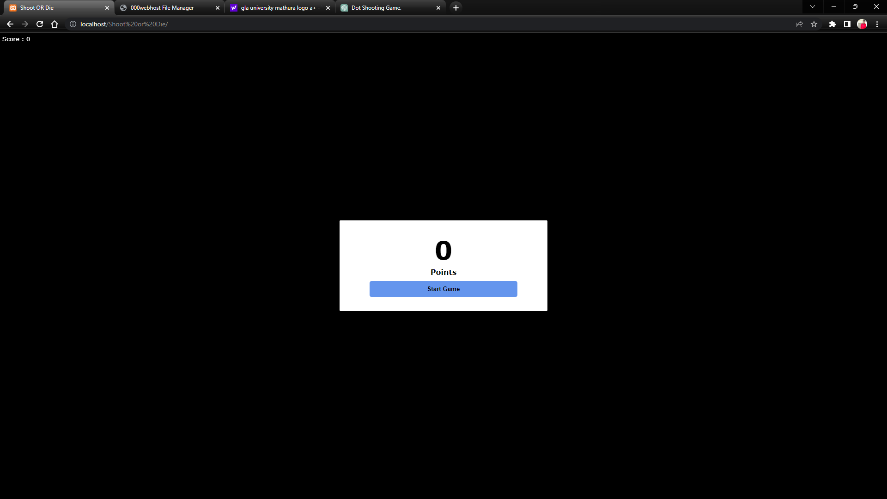
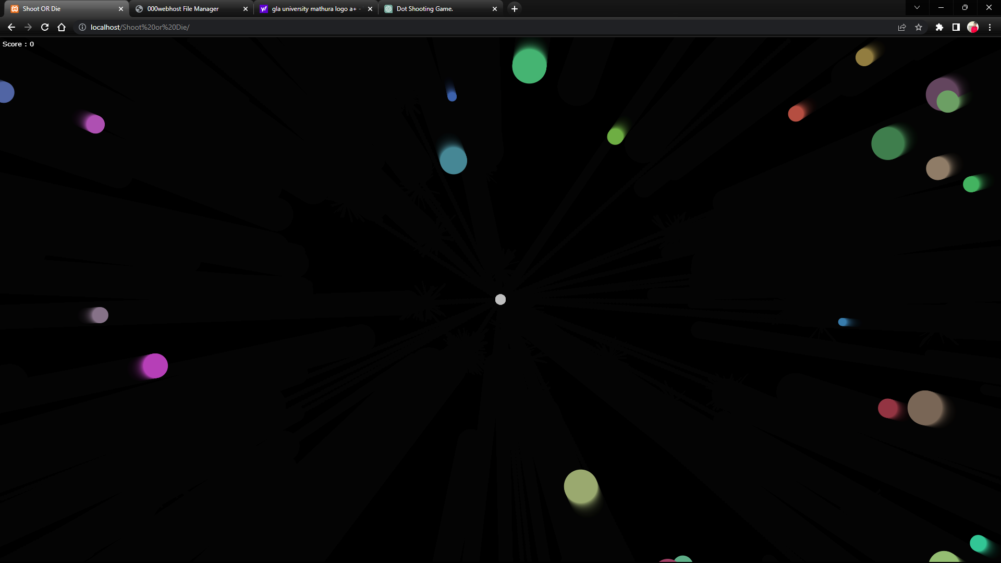
OUTPUT IMAGES

Slide 8
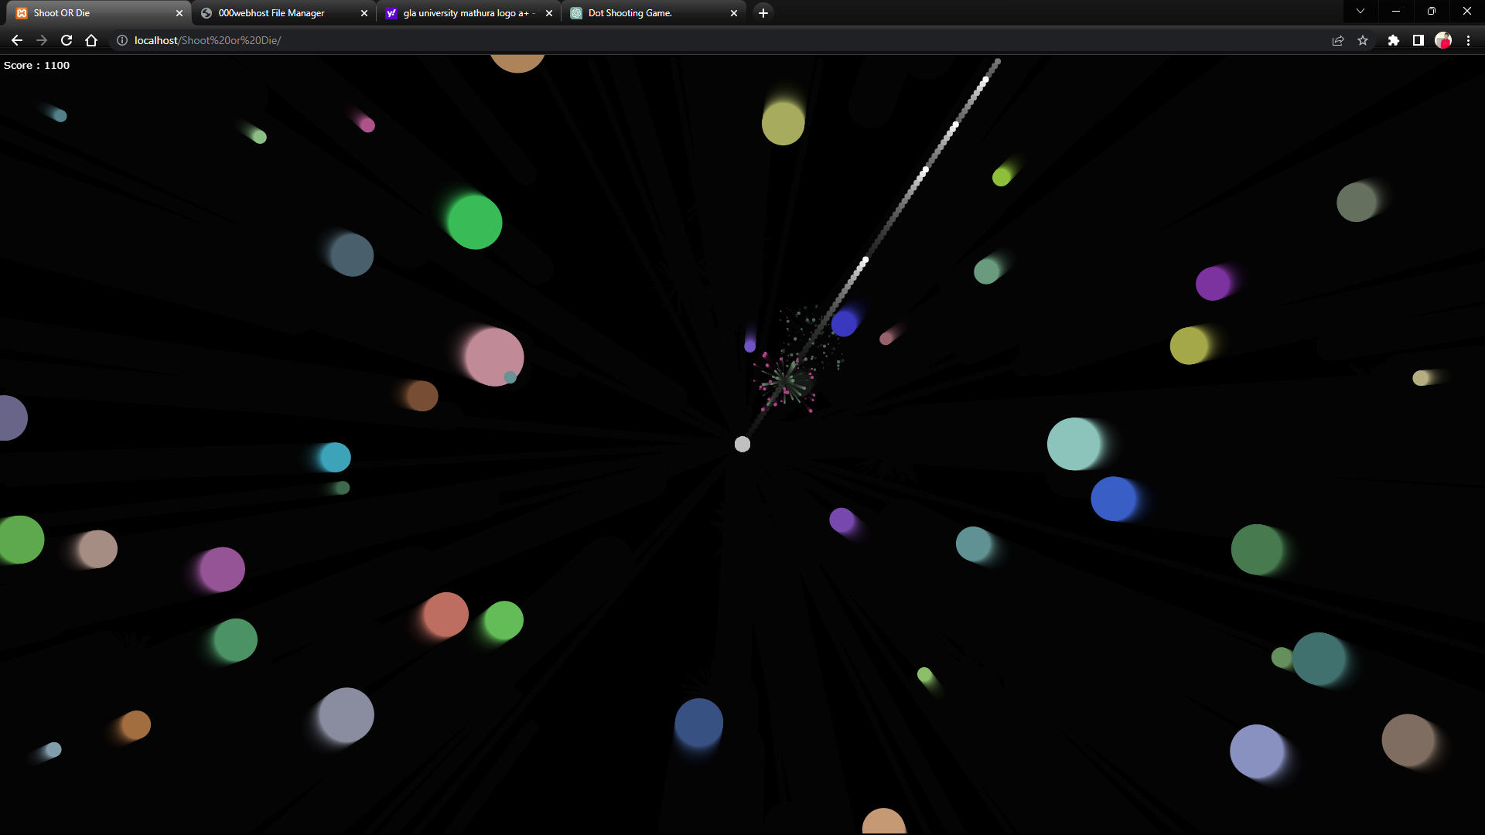
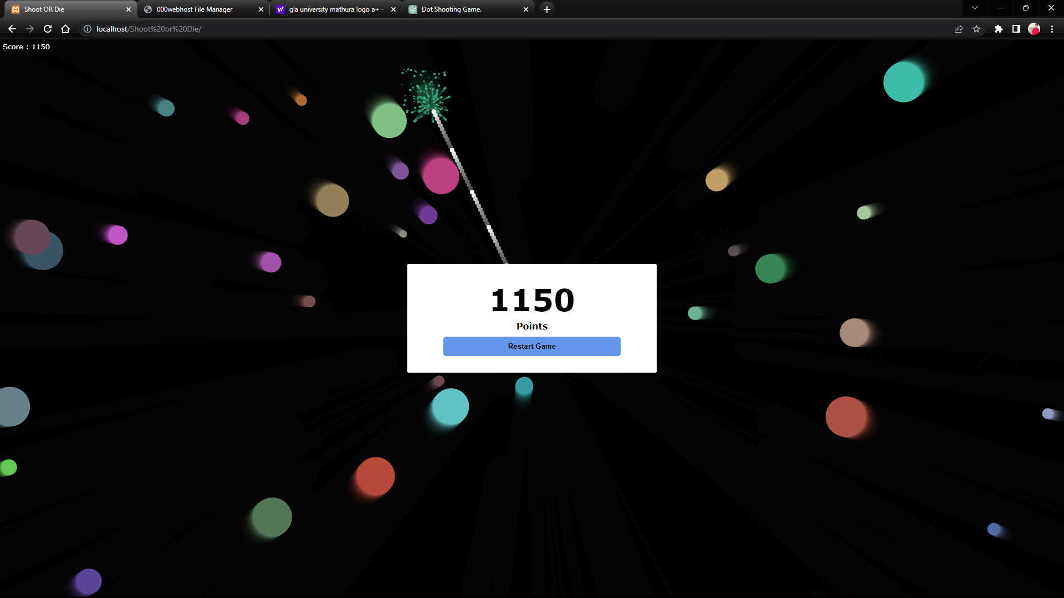

Slide 9
REFERENCES
Books:
- Head First HTML and CSS
A Learner's Guide to Creating Standards- Based Web Pages
Elisabeth Robin
Eric Freeman
﻿﻿- HTML & CSS : design and Build websites
﻿﻿- Learning Web design
- JAVAScript

Slide 10
CONCLUSION
In conclusion, the simple dot shooting game is a fun and addictive game that challenges players to test their aim and reflexes. The game involves shooting dots that move across the screen and trying to score as many points as possible. The game can be played by people of all ages and skill levels, and can be a great way to pass the time or to compete against friends. With its simple yet engaging gameplay, the simple dot shooting game is sure to provide hours of entertainment.

Slide 11
FUTURE WORK
The future goal of the simple shooting shooting game could be to add more features and levels to make the game more challenging and engaging for players. The game could also be adapted to different platforms, such as mobile devices or gaming consoles, to reach a wider audience. Additionally, the game could be integrated with social media platforms to allow players to compete and share their scores with friends. Another potential goal could be to explore virtual and augmented reality technologies to create an even more immersive gaming experience. Overall, the future of the simple dot shooting game holds many possibilities for further development and growth.

Slide 12
- THANK YOU ! -

